Slide 1

Future Tech: Innovations Shaping Tomorrow
Exploring technologies that will redefine our future
Notes:
AI-generated content may be incorrect. --- The future is being shaped by groundbreaking technologies that are transforming industries and improving lives. This presentation will explore key innovations in artificial intelligence, quantum computing, and biotechnology that are driving progress and shaping our world.

Slide 2

Agenda Items
Artificial Intelligence and Machine Learning
Quantum Computing
Biotechnology and Genetic Engineering
Notes:
In this presentation, we will first delve into artificial intelligence and machine learning, discussing recent advancements, applications across industries, and the ethical considerations involved. Next, we will explore the fascinating world of quantum computing, covering its principles, potential breakthroughs, and the challenges it faces. Finally, we will examine biotechnology and genetic engineering, focusing on CRISPR technology, medical advancements, and ethical implications.

Slide 3
Artificial Intelligence and Machine Learning
Notes:
Artificial Intelligence (AI) and Machine Learning (ML) are revolutionizing the way we interact with technology. These innovations are enhancing efficiency and effectiveness across a variety of sectors.

Slide 4
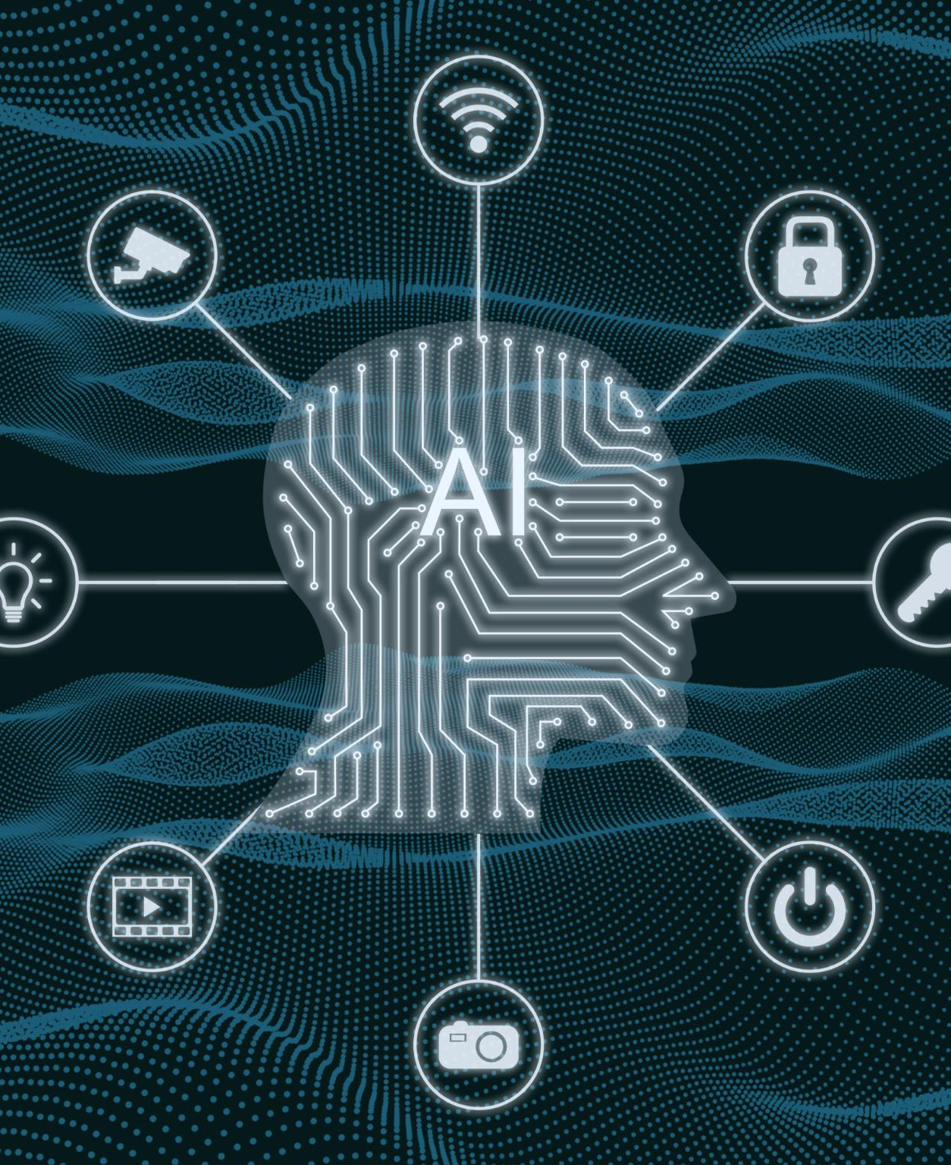
Advancements in AI Algorithms
Deep Learning Techniques
Deep learning techniques have revolutionized AI by enabling machines to learn from vast amounts of data and improve their accuracy over time.
Natural Language Processing
Natural language processing allows machines to understand, interpret, and respond to human language, enhancing human-computer interaction.
Data Analysis and Pattern Recognition
Advancements in AI algorithms enable machines to analyze data effectively, recognize patterns, and make informed predictions.
Notes:
Recent advancements in AI algorithms, such as deep learning and natural language processing, have significantly improved the ability of machines to analyze data, recognize patterns, and make predictions. These advancements are paving the way for smarter applications and systems.

Slide 5
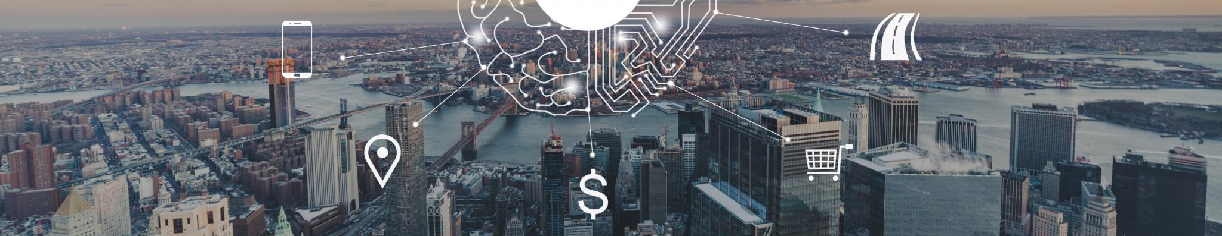
Applications in Various Industries
Healthcare Innovations
AI is enhancing predictive analytics in healthcare, improving patient outcomes and operational efficiency.
Financial Services Transformation
In finance, AI is used for fraud detection and personalized financial services, making transactions safer and more efficient.
Smart Transportation Solutions
AI and ML are revolutionizing transportation with smart traffic management and autonomous vehicles, enhancing safety and efficiency.
Entertainment Personalization
AI is transforming entertainment through personalized recommendations, enhancing user experience across platforms.
Notes:
AI and ML are being applied in numerous industries, including healthcare, finance, transportation, and entertainment. From predictive analytics in healthcare to personalized recommendations in e-commerce, AI is transforming how businesses operate and engage with customers.

Slide 6

Ethical Considerations
Bias in Algorithms
Bias in AI algorithms can lead to unfair outcomes and reinforce existing societal inequalities. Addressing this issue is crucial for ethical AI.
Data Privacy Concerns
Data privacy is a major concern as AI systems often require access to personal information, which must be safeguarded to protect individuals.
Job Displacement Risk
The advancement of AI technology raises concerns about job displacement in various sectors. Strategies must be developed to mitigate this impact.
Notes:
As AI continues to evolve, ethical considerations become increasingly important. Issues such as bias in algorithms, data privacy, and the potential for job displacement need to be addressed to ensure responsible AI deployment.

Slide 7
Quantum Computing
Notes:
Quantum computing represents a paradigm shift in computation, leveraging the principles of quantum mechanics to process information at unprecedented speeds. This section explores the fundamentals and potential of this emerging field.

Slide 8

Principles of Quantum Computing
Quantum Bits (Qubits)
Qubits are the fundamental units of quantum computing, capable of existing in multiple states at once, unlike classical bits.
Faster Problem Solving
Quantum computers can process information at unprecedented speeds, solving complex problems much faster than classical computers.
Applications of Quantum Computing
Quantum computing has the potential to revolutionize various fields, including cryptography, drug discovery, and optimization problems.
Notes:
Quantum computing operates on the principles of quantum bits (qubits), which can exist in multiple states simultaneously. This allows quantum computers to solve complex problems faster than classical computers, making them a game changer for various applications.

Slide 9

Potential Breakthroughs
Revolutionizing Cryptography
Quantum computing has the potential to transform cryptography by enabling secure communication methods that are currently unattainable.
Advancements in Material Science
With its powerful calculation abilities, quantum computing can lead to new materials discovery and innovations, impacting various industries.
Drug Discovery Innovations
Quantum computing could significantly accelerate drug discovery processes, allowing for faster and more precise identification of potential treatments.
Notes:
Quantum computing has the potential to revolutionize fields such as cryptography, material science, and drug discovery. By performing calculations that are currently infeasible, quantum computers could lead to breakthroughs in technology and science.

Slide 10

Challenges and Limitations
Error Rates
Error rates in quantum computing are a significant hurdle that must be addressed to ensure reliable computations.
Qubit Coherence
Maintaining qubit coherence is essential for the stability of quantum computations and for achieving accurate results.
Advanced Algorithms
The development of advanced algorithms is necessary to fully leverage the capabilities of quantum computing.
Notes:
Despite its promise, quantum computing faces significant challenges, including error rates, qubit coherence, and the need for advanced algorithms. Overcoming these limitations is crucial for the practical realization of quantum technologies.

Slide 11
Biotechnology and Genetic Engineering
Notes:
Biotechnology and genetic engineering are at the forefront of scientific innovation, offering solutions to some of humanity's most pressing challenges, from healthcare to agriculture.

Slide 12

CRISPR and Gene Editing
Revolutionary Gene Editing
CRISPR technology enables precise modifications to DNA, making gene editing more accessible and effective.
Curing Genetic Diseases
CRISPR opens up new possibilities for curing genetic diseases by directly targeting and modifying faulty genes.
Agricultural Advancements
This technology improves crop resilience, enabling plants to better withstand environmental stress and diseases.
Advancements in Medical Research
CRISPR technology is advancing medical research, particularly in developing personalized medicine and new treatment methods.
Notes:
CRISPR technology has revolutionized gene editing, allowing for precise modifications of DNA. This powerful tool opens up possibilities for curing genetic diseases, improving crop resilience, and advancing medical research.

Slide 13

Medical Advancements
Personalized Medicine
Personalized medicine tailors treatments to individual patients based on their genetic makeup, improving treatment efficacy.
Advanced Therapies
Advanced therapies, such as gene therapy and regenerative medicine, offer groundbreaking solutions for previously untreatable conditions.
Vaccine Development
Innovations in biotechnology have accelerated vaccine development, enhancing global health security against infectious diseases.
Notes:
Biotechnology is leading to significant medical advancements, including personalized medicine, advanced therapies, and vaccines. These innovations are enhancing patient care and improving health outcomes worldwide.

Slide 14
Ethical Implications
Gene Editing Ethics
Gene editing technologies raise significant ethical questions about the limits of human intervention in natural processes.
Genetic Privacy Issues
The collection and use of genetic data pose risks to individual privacy, demanding strict ethical standards and regulations.
Misuse of Biotechnology
Potential misuse of biotechnology can lead to harmful consequences, necessitating the development of responsible research practices.
Notes:
With the power of biotechnology comes ethical considerations. Issues surrounding gene editing, genetic privacy, and potential misuse of biotechnology need to be carefully examined to ensure responsible practices in research and application.

Slide 15
Conclusion
Future of Technology
Ethical Challenges
Societal Impact
Innovations in artificial intelligence, quantum computing, and biotechnology are reshaping our world and influencing various sectors.
As technology progresses, we must confront ethical challenges that arise to ensure responsible development and application.
Harnessing the potential of these innovations can lead to significant improvements in healthcare, communication, and daily life.
Notes:
The innovations discussed today in artificial intelligence, quantum computing, and biotechnology are shaping the future in profound ways. As these technologies continue to develop, it is imperative to address ethical challenges and harness their potential for the betterment of society.

